Slide 1
Image Preprocessing
Problems:
Light Sensitive;
Lack of Sharpness;
Background Elimination;
Approaches:
De-convention;
Thresholding;
Heat Equation;
Canny Edge Detector;
Edge Connection;
Area Filled Function; Black and White Mask;

Slide 2
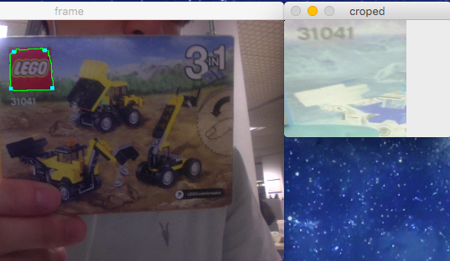
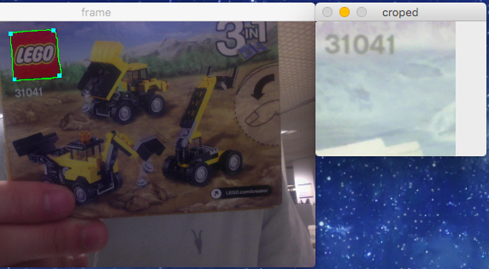
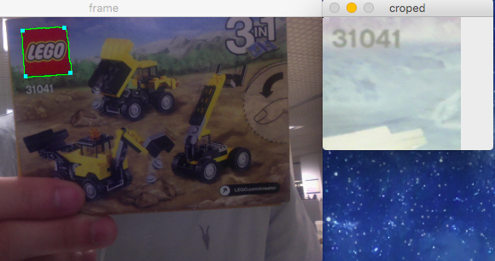
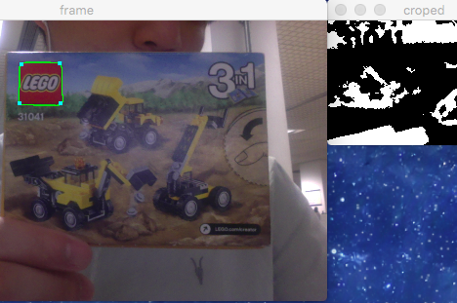
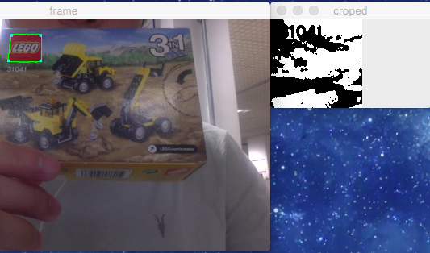
Image Preprocessing
Light Sensitive

Slide 3
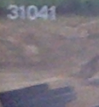
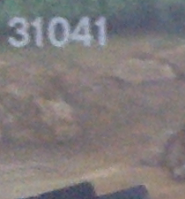
Image Preprocessing
Lack of Sharpness
Sharpness reflects how many details and how much acutance an image has. ( Clarkvision.com, 2016 )
Clarkvision.com. (2016). Clarkvision: Image Restoration 2 Using Adaptive Richardson-Lucy Deconvolution. [online] Available at: http://www.clarkvision.com/articles/image-restoration2/ [Accessed 26 May 2016].

Slide 4
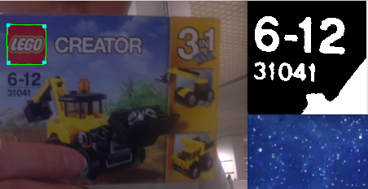
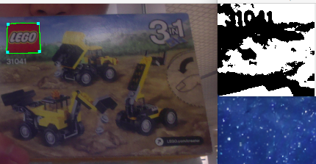
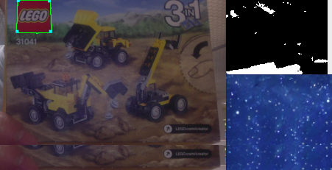
Image Preprocessing
Background Elimination
a. Good
b. Poor
c. Bad

Slide 5
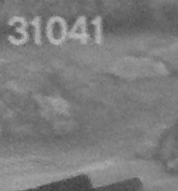
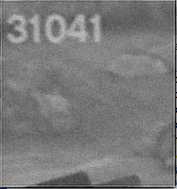
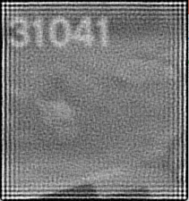
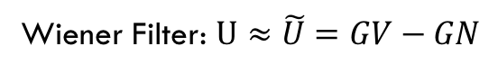
Image Preprocessing
De-convolution
a. origin
b. Sharper
c. Over Sharpness
Wiener Filter: $U≈\tilde{U}=GV−GN$

Slide 6
Image Preprocessing
Thresholding
a. Good
b. Bad
c. Optimal
Otsu Thresholding

Slide 7
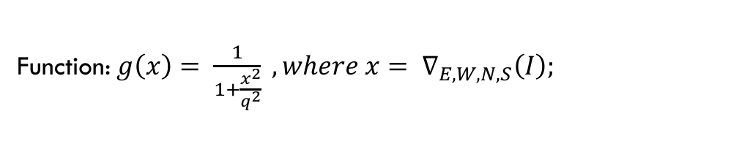
Image Preprocessing
Heat Equation
a. original
b. Edge
c. T=1/35, iteration=13
d. Edge
Function: $g\left(x\right)= \frac{1}{1+\frac{x^{2}}{q^{2}}} ,where x= ∇_{E,W,N,S}\left(I\right);$

Slide 8
Image Preprocessing
Canny Edge Detector
a. Original
b. Thresholding
c. Heat-Equation

Slide 9
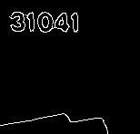
Image Preprocessing
Edge Connection

Slide 10

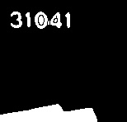
Image Preprocessing
Area Filled Function

Slide 11
Image Preprocessing
Black and White Mask

